Slide 1
Coffee Shop Sales Analysis

Slide 2
Objective
The objective of this Coffee Shop Sales Analysis is to leverage sales data to uncover key insights that will support strategic decisions and boost overall business performance

Slide 3
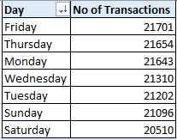
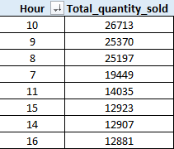
Sales by Day of the Week & Hour
Sales are highest on Friday, with 21,701 transactions, and the morning hours, particularly around 10:00 AM, see a significant increase in sales.

Slide 4
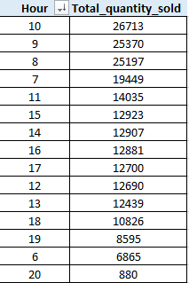
Peak Times for Sales Activity
Sales Activity peaks during the morning hours, especially between 7:00 AM and 10:00 AM

Slide 5
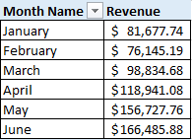
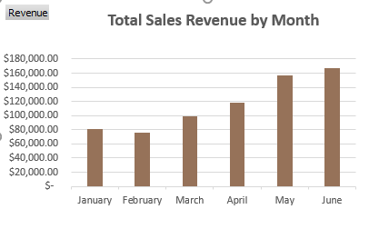
Total Sales Revenue by Month
The total sales revenue for each month:
January - $81,677.74
February - $76,145.19
March - $98,834.68
April - $118,941.08
May - $156,727.76
June - $166,485.88

Slide 6

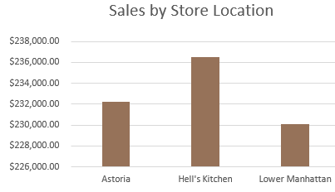
Sales by Store Location
Sales vary across different store locations, with Hell's Kitchen generating the highest revenue at $236,511.17, followed by Astoria at $232,243.91, and Lower Manhattan at $230,057.25.

Slide 7
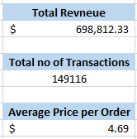
Average Price per Order
The average price per order per person is $4.69, calculated by dividing the total revenue of $698,812.33 by the total number of transactions, 149,116.

Slide 8
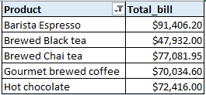
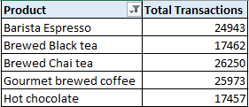
Best-Selling Products (Revenue & Quantity)
The best-selling product in terms of revenue is Barista Espresso, generating $91,406.20.
In terms of quantity, Brewed Chai Tea is the best-seller, with 26,250 units sold.

Slide 9
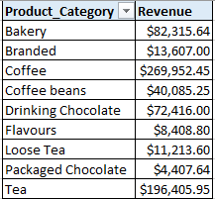
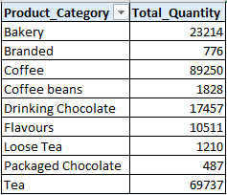
Sales by Product Category
Sales vary by product category, with the Coffee category leading in both revenue $269,952.45 and quantity sold 89,250 units, followed by Tea with revenue of $196,405.95 and 69,737 units sold.

Slide 10
Thank You

